Slide 1
Lesson objective
Title: Linear plotting
Aim:
plot real life linear relationships
Plan:
Review plotting on the cartesian plane.
Review rates
Activity plot real life linear relationships
PBiS Focus: Achieve, plan for success by practicing as much as possible

Slide 2
Expanding brackets
The leading term multiplies into EVERYTHING inside the brackets
➔ This is “simplifying” for our first step

Slide 3
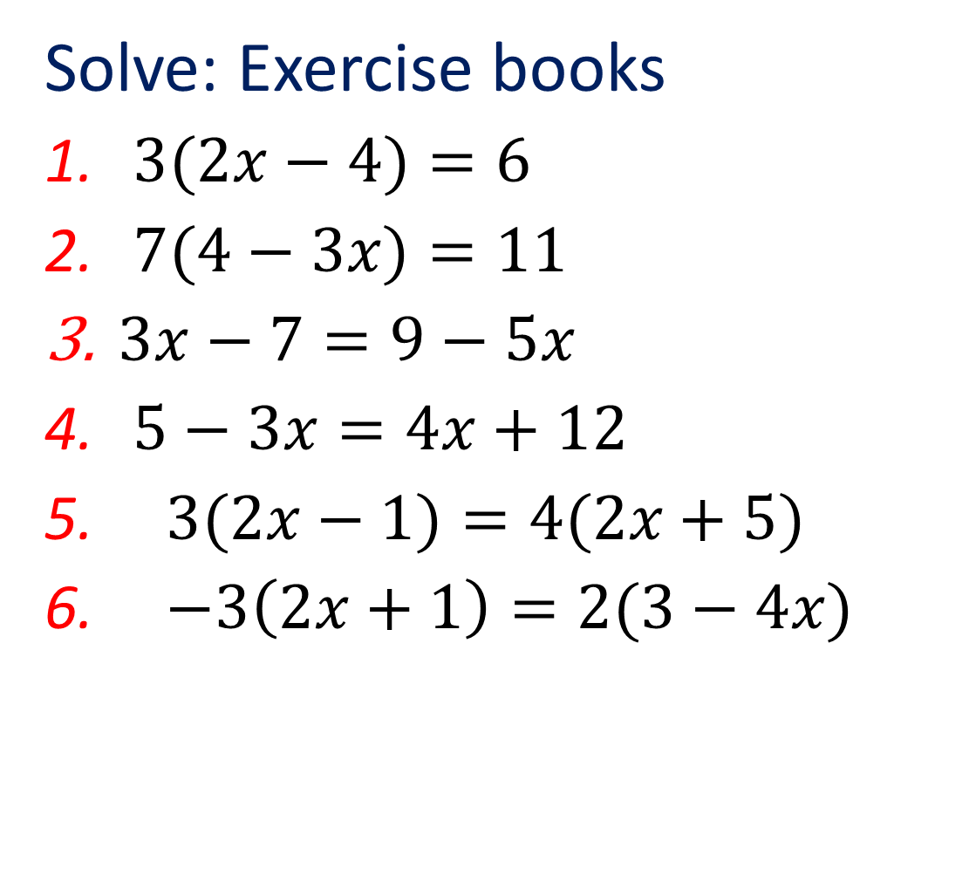
Solve: Exercise books
$3(2x−4)=6$
$7(4−3x)=11$
$3x−7=9−5x$
$5−3x=4x+12$
$3(2x−1)=4(2x+5)$
$−3\left(2x+1\right)=2(3−4x)$
Equation solving steps:
Simplify both sides
Collect variable terms to left and numbers to right – swap sides swap signs.
Simplify both sides
Divide both sides by coefficient.
Notes:
Run through one at a time. Remember to review whiteboard etiquette.

Slide 4
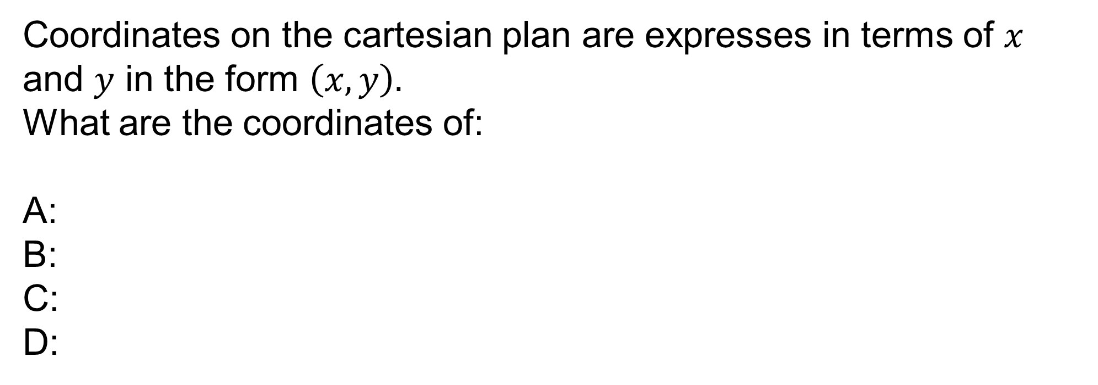
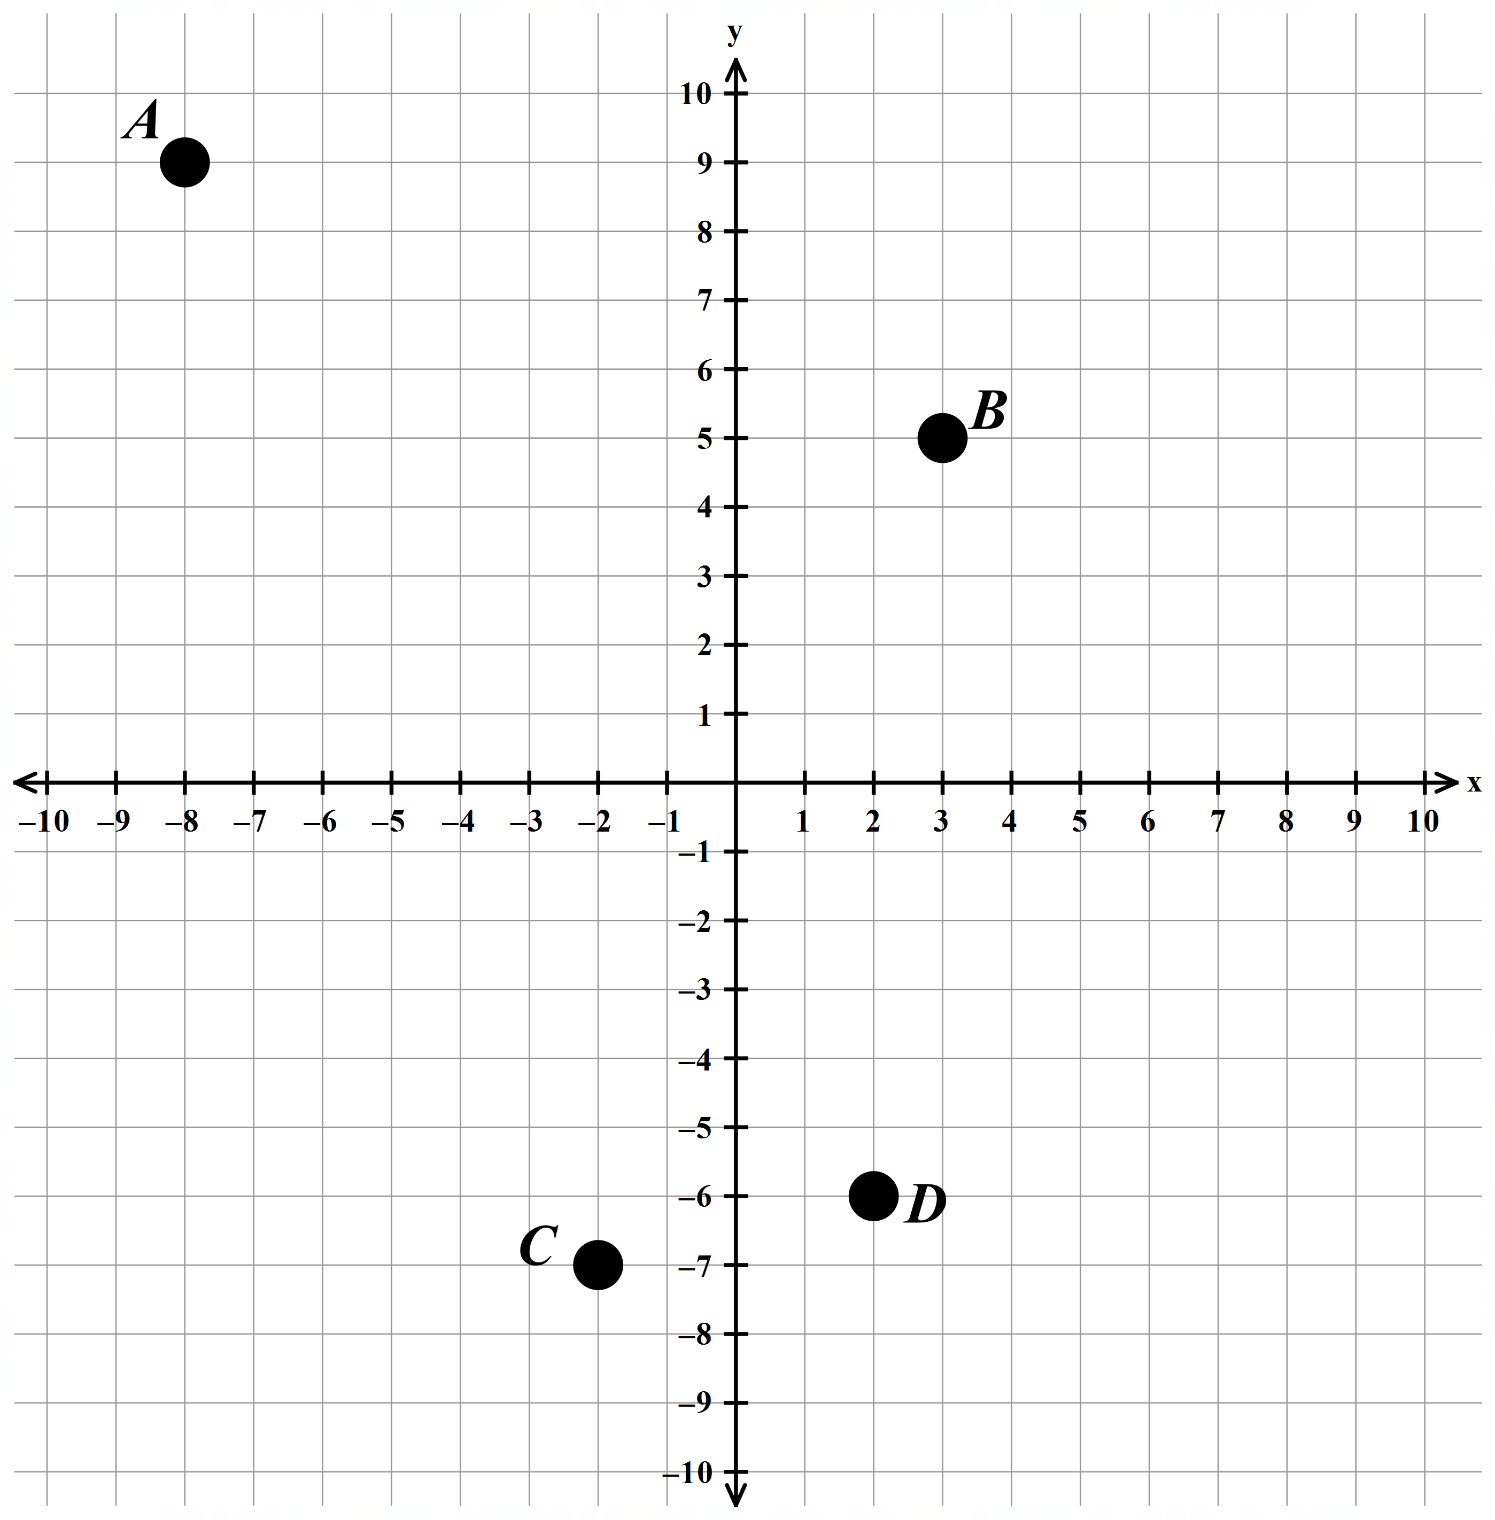
Coordinates on the cartesian plan are expresses in terms of $x$ and $y$ in the form $\left(x,y\right).$
What are the coordinates of:
A:
B:
C:
D:
(-8,9)
(3,5)
(-2,-7)
(2,-6)

Slide 5
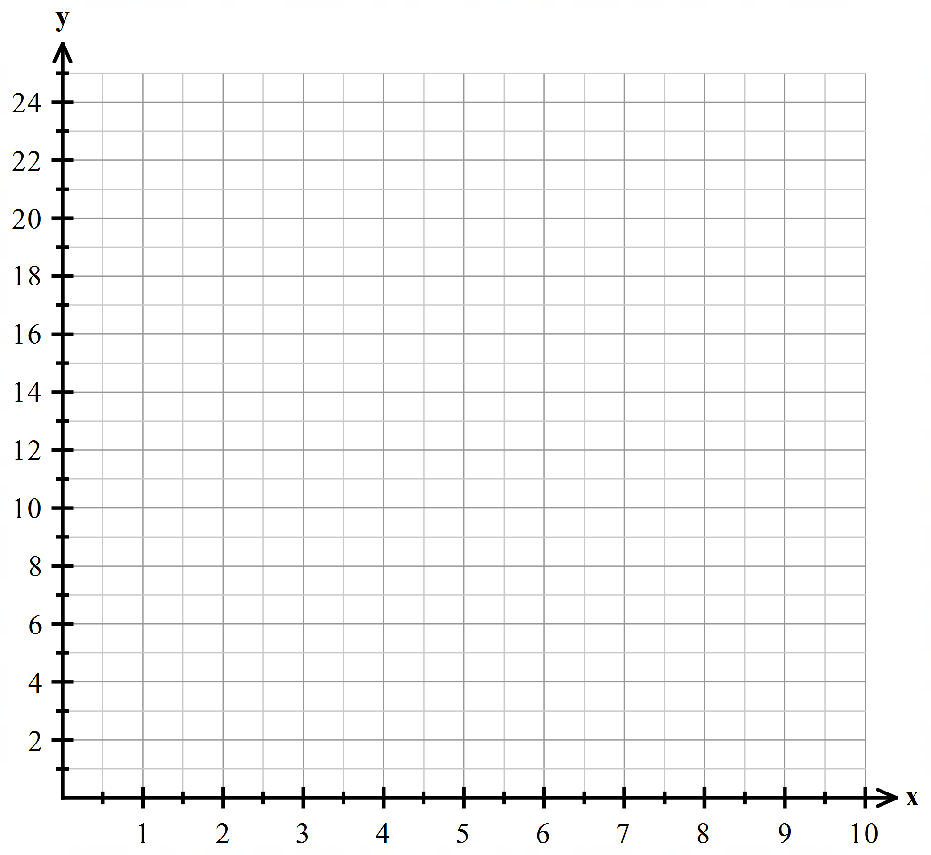

Plotting Linear Relationships
1 | I want to take a taxi to Perth. The taxi has a standard charge of $3 and charges me $2 for each Kilometre I travel. What does a graph of this equation look like? How do I calculate the total cost of a journey?
KM | x | 0 | 1 | 2 | 3 | 4 | 5 | 6 | 27
Cost | y
3
5
7
9
11
13
15
57

Slide 6
Plotting Linear Relationships
1 | I want to take a taxi to Perth. The taxi has a standard charge of $3 and charges me $2 for each Kilometre I travel. What does a graph of this equation look like? How do I calculate the total cost of a journey?
KM | x | 0 | 1 | 2 | 3 | 4 | 5 | 6 | 27
Cost | y
3
5
7
9
11
13
15
57

Slide 7


Plotting Linear Relationships
1 | I want to take a taxi to Perth. The taxi has a standard charge of $3 and charges me $2 for each Kilometre I travel. What does a graph of this equation look like? How do I calculate the total cost of a journey?
KM | x | 0 | 1 | 2 | 3 | 4 | 5 | 6 | 27
Cost | y
3
5
7
9
11
13
15
57
How much will it cost if you go:
5km
9km
7.5km
What is the function used to calculate the cost of the journey?
$13
$21
$18
$$y=2×x+3$$
Starting value
Rate

Slide 8

Plotting Linear Relationships
1 | A mobile phone company charges $10 per month connection fee. It charges $3 per MB of mobile internet data used. Plot a graph for this equation? Write an equation for the total charge for using mobile data?
Mb | x | 0 | 1 | 2 | 3 | 4 | 5 | 6 | 18
Cost | y
10
13
16
19
22
25
28
64

Slide 9
Plotting Linear Relationships
2. | A mobile phone company charges £10 per month connection fee. It charges £3 per MB of mobile internet data used. Plot a graph for this equation? Write an equation for the total charge for using mobile data?
Mb | x | 0 | 1 | 2 | 3 | 4 | 5 | 6 | 18
Cost | y
10
13
16
19
22
25
28
64

Slide 10

Plotting Linear Relationships
2. | A mobile phone company charges £10 per month connection fee. It charges £3 per MB of mobile internet data used. Plot a graph for this equation? Write an equation for the total charge for using mobile data?
MB | x | 0 | 1 | 2 | 3 | 4 | 5 | 6 | 18
Cost | y
10
13
16
19
22
25
28
64
How much will it cost if you go:
6MB
8MB
4.666MBkm
What is the function used to calculate the cost of the journey?
$28
$24
$24
$$y=3×x+10$$
Starting value
Rate

